Slide 1

Project Title: ATOMIC DICTIONARY Course Title: OBJECT ORIENTED PROGRAMMING
BSCSE
Submitted To:
Samia Yasmin
Lecturer
Department of Computer Science & Engineering
Uttara University, Bangladesh

Slide 2



OUR TEAM
LUTFUN NAHAR BARSHA
MD. RIAD HASAN
MD. KOWSER MAHMOOD
ID: 2233081 334
BATCH : 60
SECTION : I
ID: 2233081 332
BATCH : 60
SECTION : I
ID: 2233081 349
BATCH : 60
SECTION : I

Slide 3
TABLE OF CONTENTS
01
02
INTRODUCTION
OBJECTIVES
03
04
FEATURES
SOFTWARE & TOOLS

Slide 4
TABLE OF CONTENTS
05
06
PROJECT DESIGN
CHALANGES FACED
07
08
FUTURE PLANS
CONCLUSION

Slide 5
01
INTRODUCTION
The Atomic Dictionary is a desktop app that helps users quickly find information about elements. By entering an element's name or symbol, users can easily access its details. This project makes learning about the periodic table simple and efficient. It is referenced by Modern Periodic Table.

Slide 6
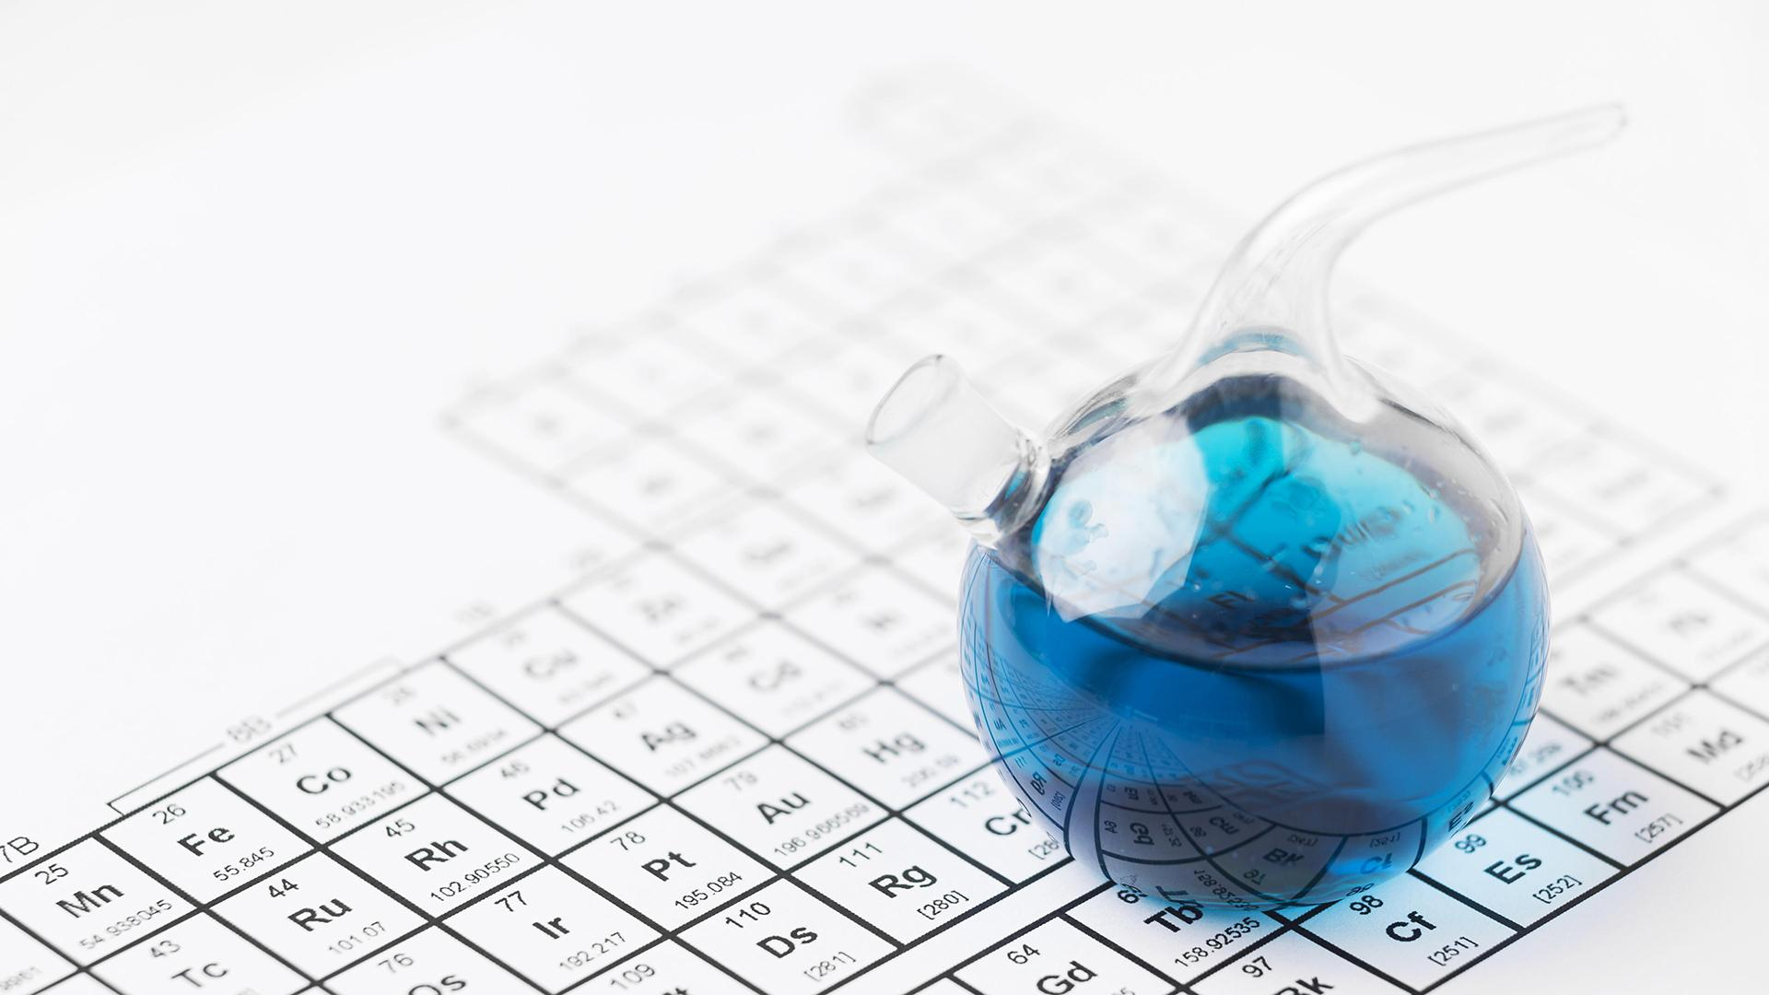
History: The modern periodic table is credited to Dmitri Mendeleev, who created the first version in 1869, and Henry Moseley, who later refined it by arranging elements based on atomic number rather than atomic mass.

Slide 7
THE MODERN PERIODIC TABLE

Slide 8
02
OBJECTIVES
To create an easy-to-use app for exploring the periodic table.
To provide accurate and detailed information about elements in one tap.
To improve skills in software development using C# as well.

Slide 9
THE KEY INFORMATIONS THAT WE’LL PROVIDE
Atomic number
26
55.845
Atomic Mass
Symbol
Fe
Solid
State
Name
Iron
Melting point
1,538 K
2,862 K
Boiling point

Slide 10
03
FEATURES
Search for elements by name or symbol.
View detailed information like atomic number, weight, and group.
Easy navigation with a simple and user-friendly interface.

Slide 11


04
SOFTWARE AND TOOLS
Programming Language: C#
Development Environment: Visual Studio Community 2022
Reference: Periodic Table Data

Slide 12
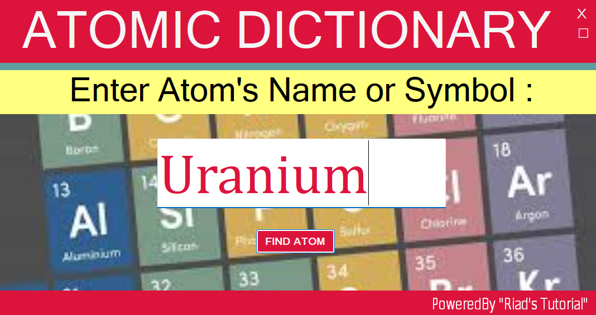
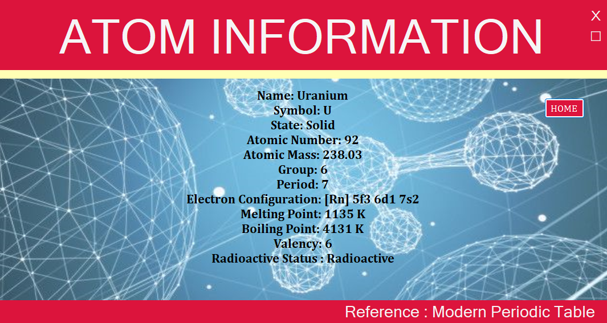
PROJECT DESIGN
05
We have two forms for the project.
Form 1: Takes input from User.
Form 2: Provides output for the particular atom.
It has Navigation Workflow like, Keyboard shortcuts for quick actions (Enter to search, Esc to return).

Slide 13
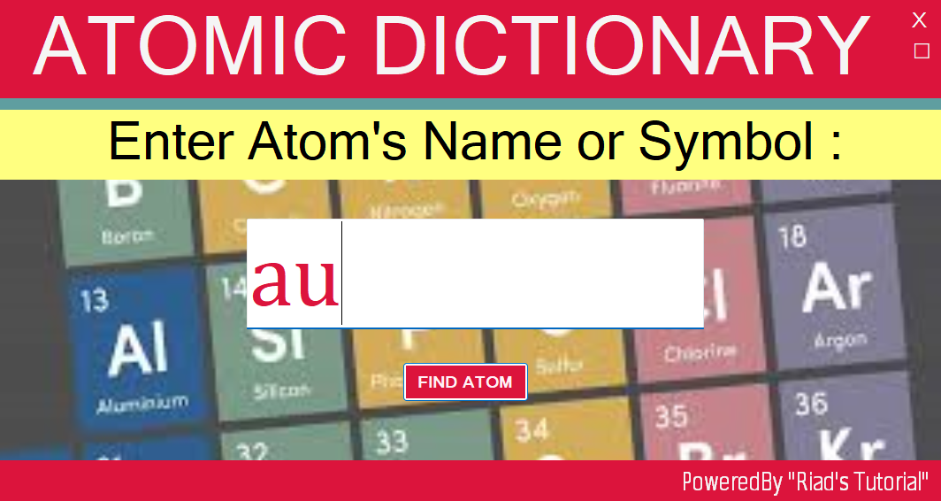
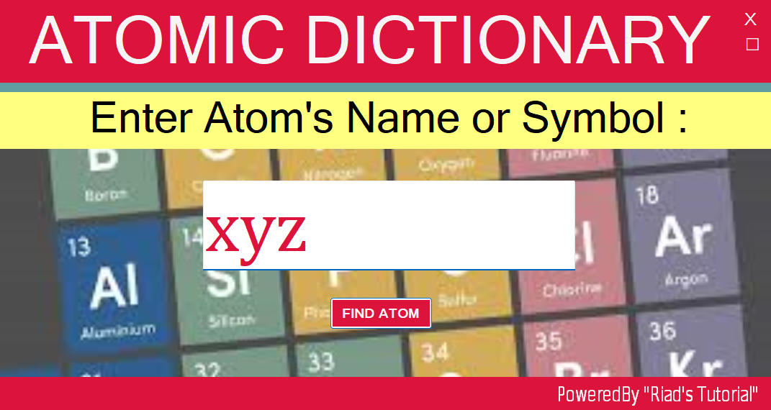
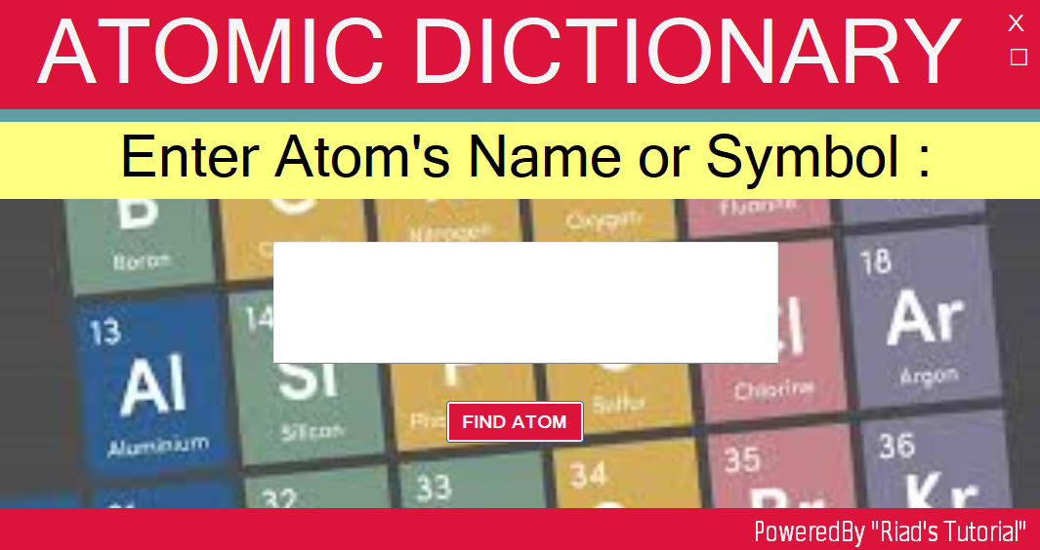
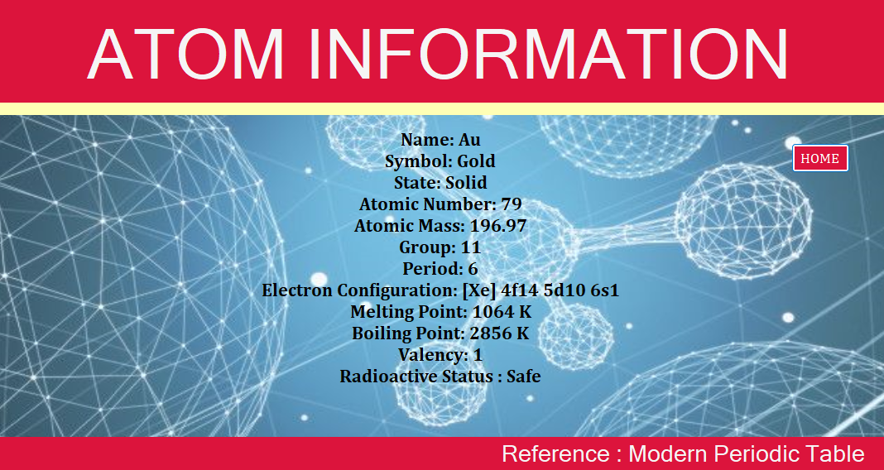
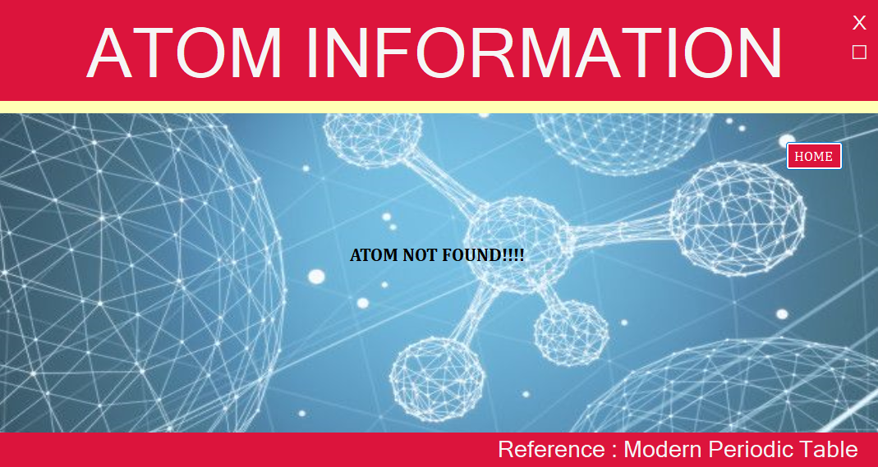
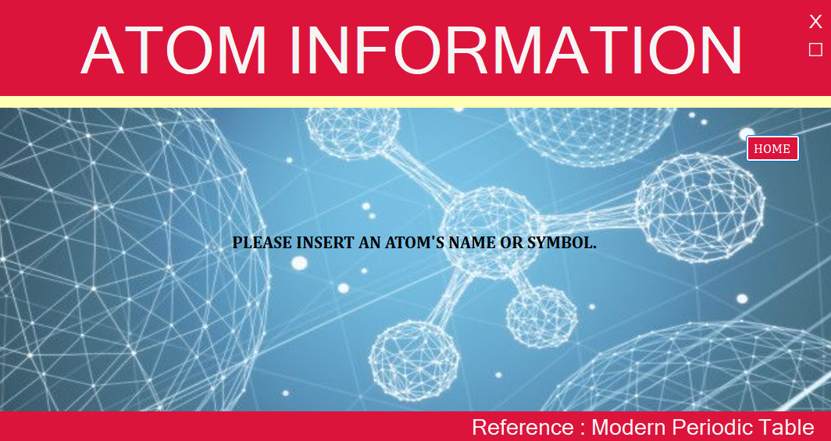
PROJECT DESIGN : Outputs

Slide 14
06
CHALLENGES FACED
Form Navigation Issue
Data Retention in Input Field
Key Functionality

Slide 15
07
FUTURE PLANS
Develop the Atomic Dictionary for Android devices.
Implement an auto-suggest feature in the input box to help users find elements faster.

Slide 16
08
CONCLUSION
That’s all about our project. We tried to make it more smooth and user-friendly. We are now in initial stage but hoping to do better with our future plans on this project.

Slide 17
THANKS
Do you have any questions?

